Slide 1


Slide 2
TEAM MEMBERS
Sujin.T
Aron Herso.S
Charles Lifrin Pakiyam.J.J
Sabin.M

Slide 3
TEAM DETAILS
Team No : PNT2022TMID52282
College Name : Stella Mary’s College of Engineering
Department : Computer Science And Engineering

Slide 4
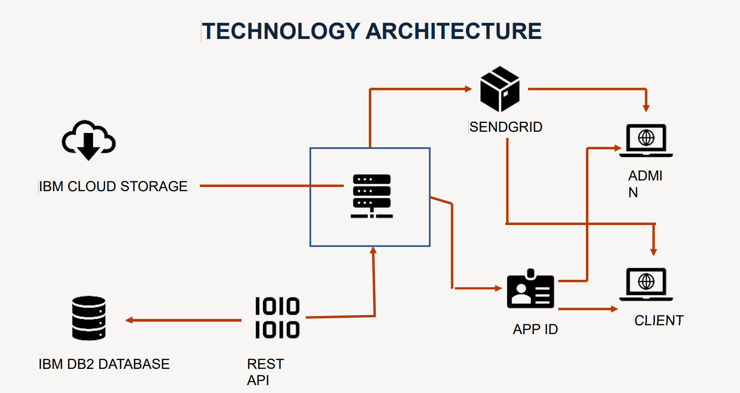

Slide 5
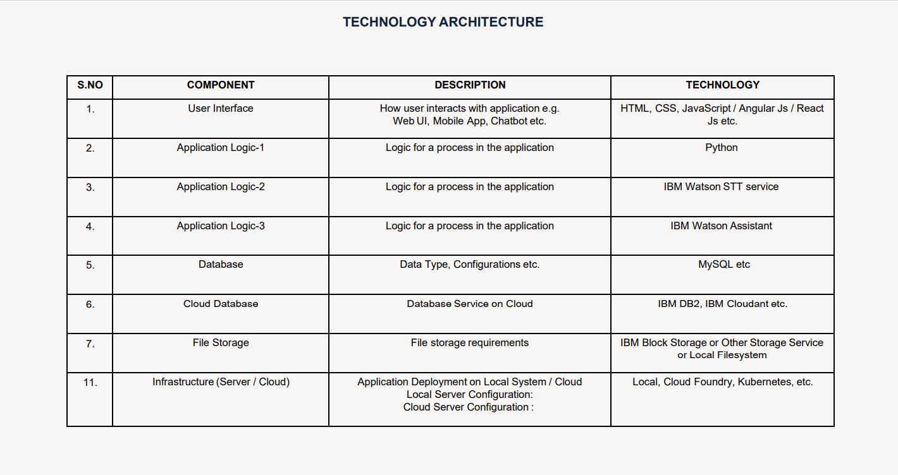

Slide 6
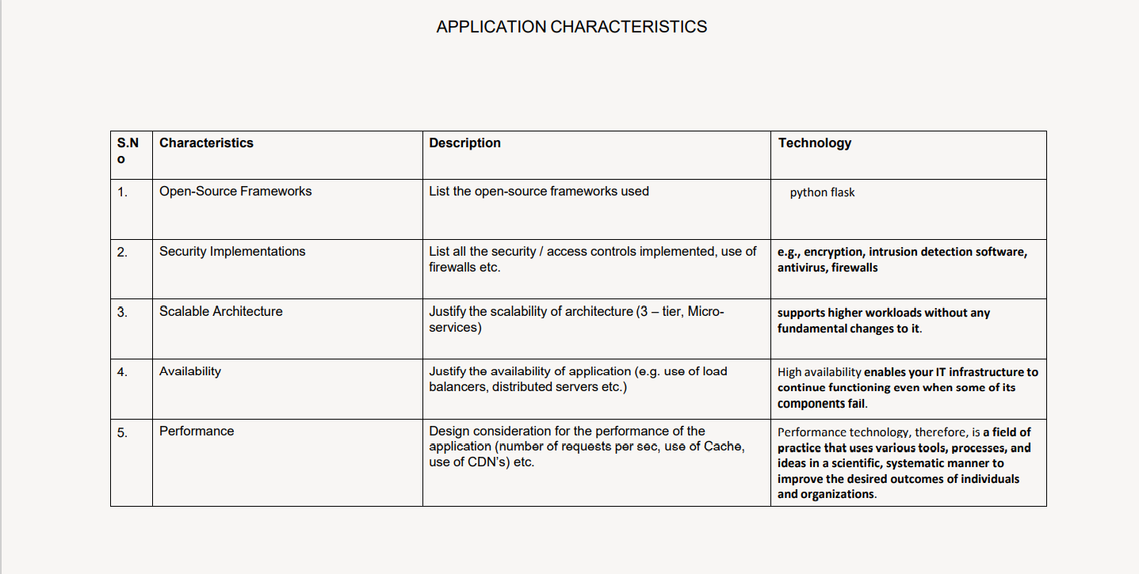

Slide 7


